Slide 1
Seven Stages of New Product Life Cycle Development Process
Building new products and services can be a process filled with uncertainty. However, following the systematic New Product Development process can help businesses gain clarity and confidence in what they are building.

Slide 2
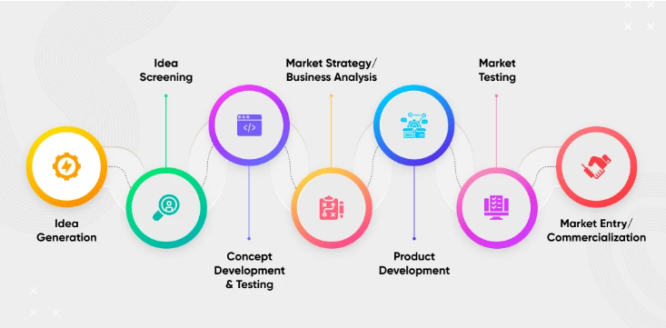

Slide 3
Stage 1: Idea Generation
The goal should be to generate many worthy ideas that can form the foundation for the New Product Development strategy. The major focus for stage 1 should be to arrange brainstorming sessions where solving customer problems are given precedence. This phase is not about generating foolproof ideas that are ready for implementation. Instead, raw and unproven ideas that can be shortlisted later should be discussed.

Slide 4
Here’s how a business can do Idea Generation:
1. Emphasize on Customer Problems
Personal Problems
Qualify Each of the Listed Problems
Coming Up With Possible Solutions
Narrowing Down Problems + Solutions

Slide 5
Emphasize on Customer Problems
The problem that is well described is a problem half-solved. Here’s how to identify the issues that the target audience is facing:
a. Personal Problems
It is a good idea to look at problems the business is facing to come up with the idea. All a business needs to focus on that specific problem and build a solution that can be tagged as a “one for all” solution to the common problem.
b. Qualify Each of the Listed Problems
This step helps check the feasibility of the shortlisted problems and their solutions based on the 4U approach by Michael Skok, the founder of Startup Secrets. The 4U approach are discussed in the next slide:
c. Coming Up With Possible Solutions
If a problem has been identified, it’s time to look for possible solutions. For every user problem, there ought to be potential New Product Development opportunities. Here’s the workflow that starts with a problem and ends with strategizing around the solution.

Slide 6
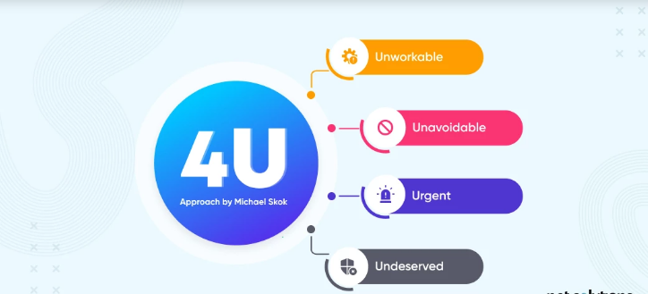

Slide 7
Unworkable: Figure out whether the brainstormed product concepts will address some real problems. Will the product be able to fill the existing customer experience gaps and will the product achieve product-market fit?
Unavoidable: Is the problem the product will address unavoidable to the extent that it becomes mandatory to comply? It is necessary to find out whether solving that problem is a choice or a compulsion.
Urgent: Is the problem urgent and is a solution highly demanded by the target market? If the answer is affirmative, this could be a chance to cover the white space in the market with the original product.
Underserved: Are there no available products that address the existing user problems? Look for the whitespace in the market and hold on to the idea that looks promising.

Slide 8
Coming Up With Possible Solutions
If a problem has been identified, it’s time to look for possible solutions. For every user problem, there ought to be potential New Product Development opportunities.

Slide 9
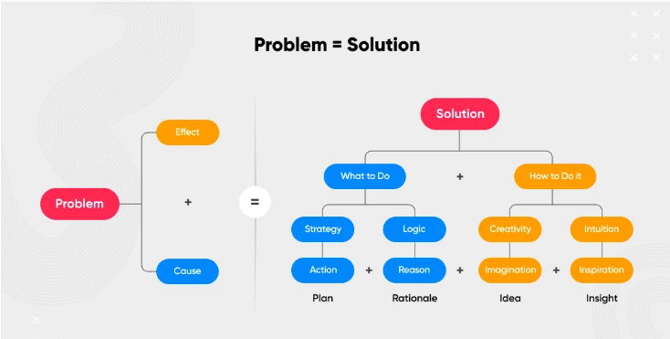

Slide 10
In all, no matter how common or uncommon the problem is, the solution should be unique. Even if a product already exists, ensure that the product can solve problems differently. For instance, Slack and Zoom are both SaaS products that focus on promoting communication and collaboration. Zoom, however, does this differently by also enabling the conducting of webinars. In other words, webinars are their unique selling point (USP).

Slide 11
Narrowing Down Problems + Solutions
Create a comparison chart that lists all the shortlisted problems and solutions. Circulate the findings across the organizational structure to develop a viable problem set. If the stakeholders are not convinced regarding the shortlisted idea, try the Replicate, Re-Purpose, and Upgrade approach.

Slide 12
Replicate: This focuses on creating a similar product as that of a competitor but launching it in new market conditions. When done with launching the minimum viable product (MVP), the strategy should be to expand the business by introducing out-of-the-box and unique features later on.
Re-Purpose: This focuses on rewiring an existing business model. For instance, LinkedIn introduced LinkedIn Learning, an e-learning platform for professionals. This product was similar to an e-learning platform for students. However, they built new opportunities for expanding the target audience and market share.
Upgrading: This concept of New Product Development revolves around introducing a new business model that is better than existing solutions. Better could mean improved performance, better speed, addressing the challenges that a competitor is facing, or introducing added functionalities.

